Slide 1
Database
Management System
Lecture - 31

Slide 2
Inner join
Only those rows from both tables are merged that have same value for the common attribute; equijoin
Implemented by different methods

Slide 3
Inner join
Common attributes need not to have same name, but must have same domain
Applied generally between tables having referential integrity between them

Slide 4
PROGRAM
COURSES
STUDENT
CRS_OFFERED
SEMESTER
TEACHER

Slide 5
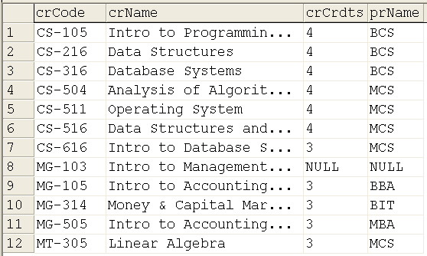
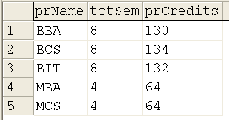

Slide 6
Inner Join
SELECT *
FROM course INNER JOIN program
ON course.prName = program.prName
Select * FROM
Course c inner join program p
ON c.prName = p.prName

Slide 7
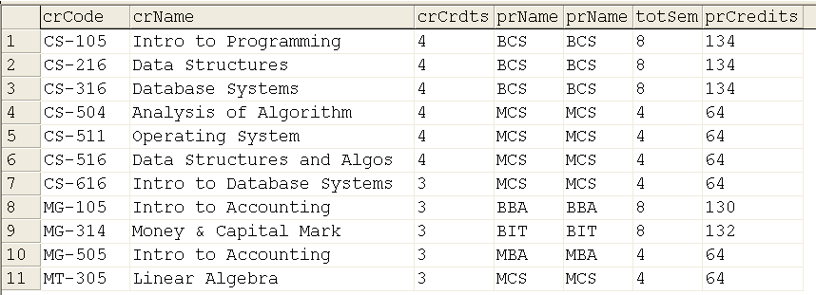

Slide 8
Inner Join
Can also be performed using the where clause, like
SELECT * FROM course, program
WHERE
course.prName = program.prName

Slide 9
Outer Join
Inner join plus the missing rows from one or more tables
Left, Right and Full Outer Joins

Slide 10
Outer Joins
Right Outer Join: Inner join plus rows from the non-matching rows from right table
Left outer join performs the same thing but missing rows of the left side table

Slide 11
Outer Joins
A Left Outer Join B = B Right Outer Join A
Missing values are replaced with NULLs
Full Outer Join: Inner join plus the non-matching rows from both tables

Slide 12
Outer Join Examples
Select * from course c LEFT OUTER JOIN program p on c.prName = p.prName
Select * from program p RIGHT OUTER JOIN course c on c.prName = p.prName

Slide 13
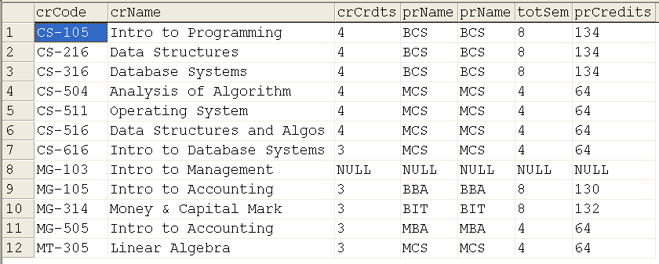

Slide 14
Outer Join Examples
Select * from program p LEFT OUTER JOIN course c on p.prName = c.prName
Select * from course c RIGHT OUTER JOIN program p on c.prName = p.prName

Slide 15
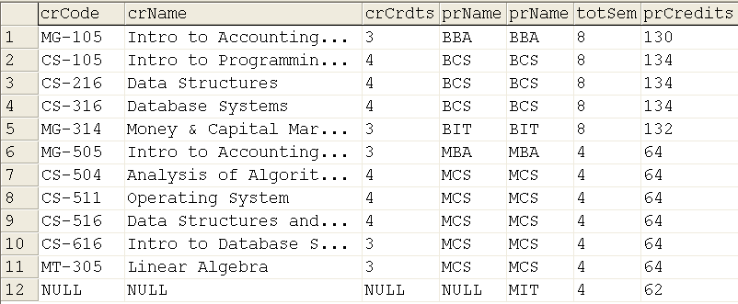

Slide 16
Full Outer Join
SELECT * FROM program p FULL OUTER JOIN
course c
ON p.prName = c.prName

Slide 17
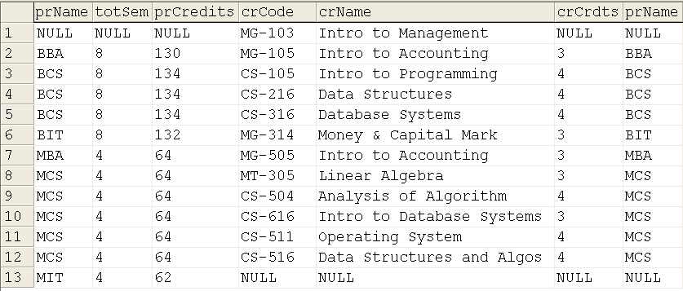

Slide 18
Semi Join
First inner join and then projected on the attributes of one table
Advantage: tells the rows involved in join
No operator available as such, but can be implemented by select_list

Slide 19
Semi Join Example
SELECT distinct p.prName, totsem, prCredits FROM program p inner JOIN course c
ON p.prName = c.prName

Slide 20
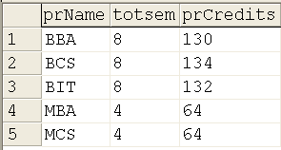

Slide 21
Self Join
Applied on the same table having referential integrity constraint implemented onto itself
ALTER TABLE student
ADD cr char(5)
REFERENCES student(stId)

Slide 22
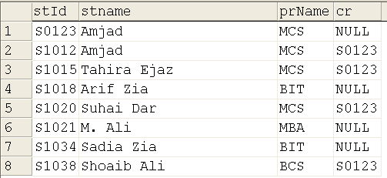

Slide 23
Self Join
SELECTa.stId, a.stName, b.stId, b.stName FROM student a, student b
WHERE (a.cr = b.stId)

Slide 24
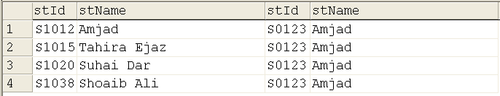

Slide 25
Subqueries
A query within a query
Useful when condition has to be applied against an unknown value
Get the names of those students who have more cgpa than that of maximum of BCS students

Slide 26
Subqueries
Can be used anywhere where an expression is allowed
Given in parentheses
Generally in where
Can be nested

Slide 27
Subqueries
Careful about operator; depends whether subquery returns single or multiple values
SELECT * from student where cgpa > (select max(cgpa) from student where prName = 'BCS‘)

Slide 29
Subqueries
SELECT * from student
WHERE cgpa =
ANY (select max(cgpa)
FROM student
GROUP BY prName)

Slide 30
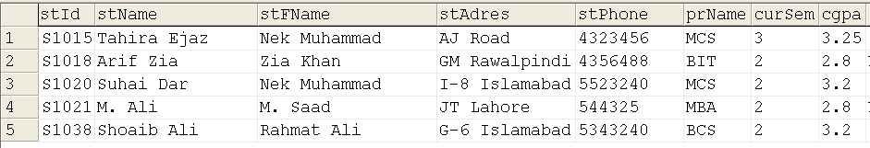

Slide 31
Wrap up DML
That is it that we have to cover about DML in this course, and the golden rule
“Practice makes even the students perfect”

Slide 32
DCL
D.I.Y
Subqueries, Summary of DML and DCL need to be discussed in detail in handouts,

Slide 33
Database
Management System
Lecture - 31

